Slide 1
Operating Systems
Course #8 Process scheduling
Răzvan Daniel ZOTA
Faculty of Cybernetics, Statistics and Economic Informatics
zota@ase.ro
https://zota.ase.ro/os

Slide 2
Process scheduling – what is all about?
Basically, it represents the way a process is “attached” to the processor
It’s centered around efficient algorithms
A scheduler design must assure that all users have fair access to resources.

Slide 3
CPU scheduling
Main concepts (recap)
Multiprogramming Multiple programs can be in memory in the same time. The CPU and I/O can be overloaded.
Jobs (Batch) programs that are running without the user intervention.
User programs (Time sharing) programs that may need user intervention
Process Can be both
CPU - I/O burst cycle There are representing the execution of the processes alternating between CPU activity and I/O. The CPU times are a lot smaller comparative with I/O operations.
Preemptive scheduling An interrupt is stopping the current running process and replacing it with another process.

Slide 4
CPU scheduling
Performance evaluation criteria
Operation degree The time fraction when a device is used (operation_time/total_time)
Throughput The number of jobs terminated in a period of time (jobs/second )
Service time Time used by a device to solve a request (in seconds)
Queue waiting time Time spent in the waiting queue (in seconds)

Slide 5
CPU scheduling
Performance evaluation criteria
Residence time Time spent by a request at a device.
Residence time= Service time+ Queue waiting time
Response time Time used by the system to respond to a user job (in seconds).
“Thinking” time Time used by the user of an interactive system in order to make up the next request (in seconds).
The main purpose of the scheduler is to optimize these times.

Slide 6
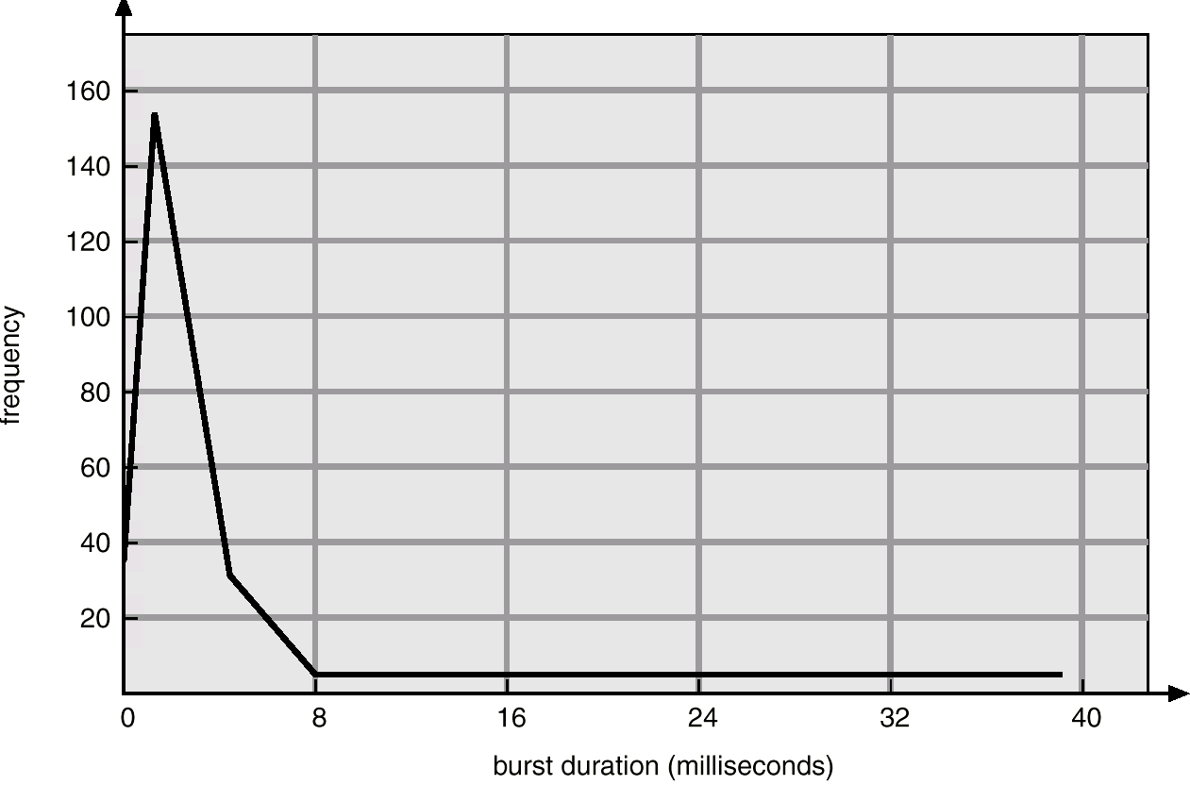
CPU scheduling
Most of the processes are not using efficiently their allocated time. The processors’ utilization is made in burst cycles like the one from the figure below:

Slide 7
Scheduling algorithms - examples
First In, First Out (aka: First come, first served):
FIFO
Simple and fair but with weak performances. The medium waiting time in queue can be pretty high.

Slide 8
Scheduling algorithms – FIFO example
Example:
Process Arrival time Service time
1 0 8
2 1 4
3 2 9
4 3 5
FIFO
P1
P2
P3
P4
0
8
12
21
26
Average residence time = ( (8-0) + (12-1) + (21-2) + (26-3) )/4 = 61/4 = 15.25
CPU residence time

Slide 9
Scheduling algorithms – SJF example
Shortest Job First (SJF):
The algorithm is optimal for minimizing the queue waiting time but impossible to implement in practice. Next process to come must be foreseen by the historical basis.
Time prediction that the process will use for the next scheduling:
t( n+1 ) = w * t( n ) + ( 1 - w ) * T( n )
where: t(n+1) next burst time
t(n) actual burst time
T(n) previous burst average
w weighted factor reflecting current or previous bursts

Slide 10
Scheduling algorithms – preemptive approach
Features for preemptive algorithms:
In this case, the process is stopped from execution when another process with a higher priority is ready for execution
It can be applied in case of SJF and in case of priority based scheduling
It avoids CPU monopolization by a single process
In case of time sharing it is necessary to implement this technique because the CPU must be protected by the processes with small priorities
If shorter jobs have higher priority, the response time is better

Slide 11
Scheduling algorithms – SJF example
Example:
Process Arrival time Service time
1 0 8
2 1 4
3 2 9
4 3 5
Preemptive SJF
P1
P2
P4
P1
P3
0
1
5
10
17
26
Average residence time = ( (5-1) + (10-3) + (17-0) + (26-2) )/4 = 52/4 = 13.0

Slide 12
Priority based scheduling
Priority based scheduling:
Each process is assigned a priority. The scheduler selects the first process with the highest priority. All the processes with the same priority are in a FIFO list.
The priority can be set by the user or by a default mechanism. The system can determine the priority function of memory needs, time limits or other constraints.
Starvation – it’s the phenomenon that appears when a process with a lower priority never executes. Implementation solution: a variable that will store the “age”.
It must maintain a balance between “saying yes” to interactive jobs without having “starvation” for batch jobs.

Slide 13
Round Robin scheduling
ROUND ROBIN
It uses a timer to generate an interrupt after a specified period of time. The preemptive multitasking is assured if a task exceeds the allocated quantum.
In slide 15 we are testing the previous example for a quantum = 4 sec.
Definitions:
Context switching – Modifying the running state from one process to another (memory change).
Processor sharing– Using a quantum such that every process will run for a maximum amount of time specified by that quantum.
Rescheduling latency – represents the waiting time from the moment when a process makes a running request till the moment it is running.

Slide 14
Round Robin scheduling (cont.)
ROUND ROBIN
A quantum is selected:
If it’s too short – too much time will be lost by context switching
If it’s too long – rescheduling latency will be too big. If many processes want to run, then a lot of time is lost as in the FIFO case.
It is adjusted such that most of the processes won’t use their running time.
More info about scheduling and quantum in Windows: https://www.microsoftpressstore.com/articles/article.aspx?p=2233328&seqNum=7

Slide 15
Scheduling algorithms – Round Robin example
Example:
Process Arrival time Service time
1 0 8
2 1 4
3 2 9
4 3 5
Round Robin, quantum = 4, no priorities
P1
P2
P3
P4
P1
P3
P4
P3
0
4
8
12
16
20
24
25
26
Average residence time = ( (20-0) + (8-1) + (26-2) + (25-3) )/4 = 74/4 = 18.5
Notes:
What is the average residence time in case of:
quantum=3 Average residence time = ( (16-1) + (21-3) + (23-0) + (26-2) )/4 = 80/4 = 20
Quantum=5 Average residence time = ( (9-1) + (19-3) + (22-0) + (26-2) )/4 = 70/4 = 17.5
Quantum=8 Average residence time = ( (8-0) + (12-1) + (25-3) + (26-2) )/4 = 65/4 = 16.25

Slide 16
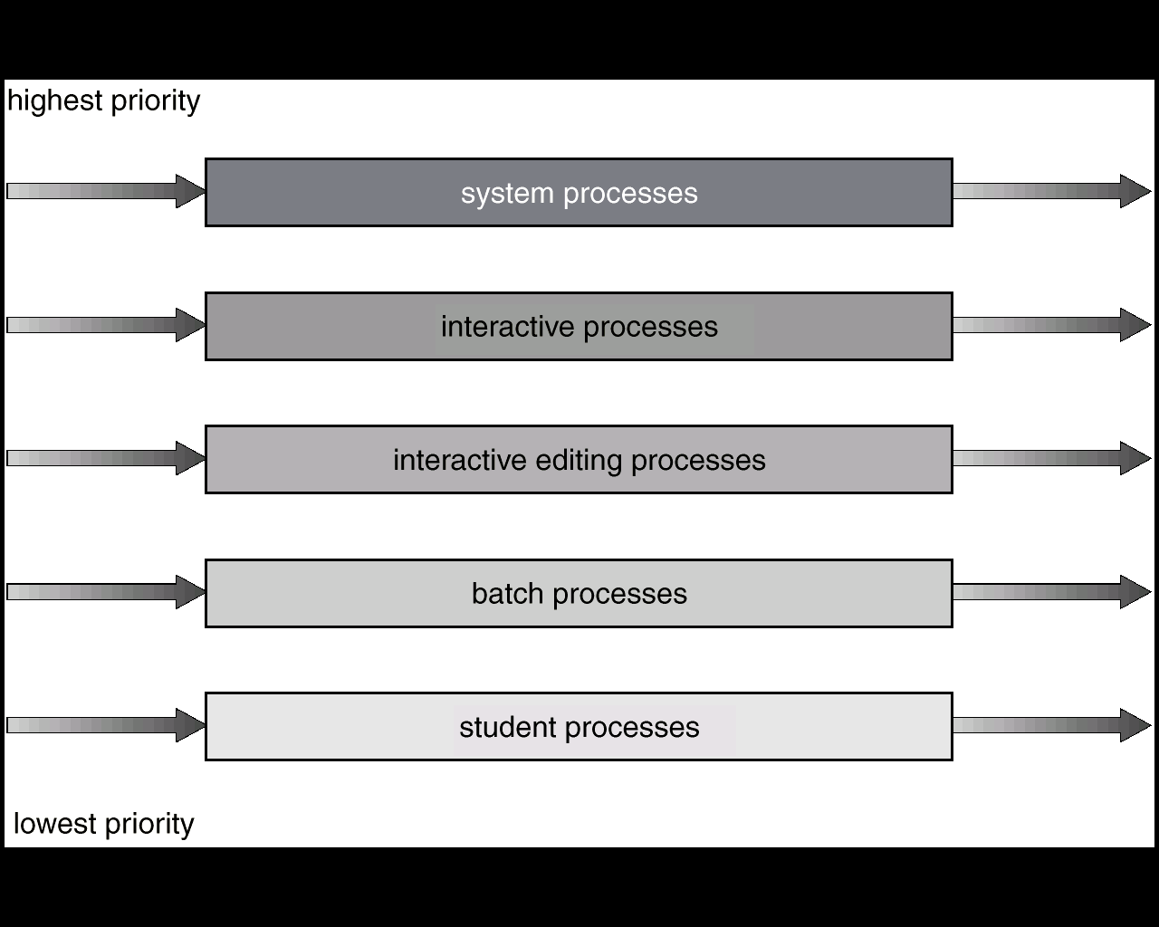
Scheduling algorithms – multi level queues
Multi level queues
Each queue has its own scheduling algorithm
Another algorithm (based on priorities) ensure the arbitration between queues
Complex method, but flexible
In this way different processes are separated: system processes, interactive, batch, favored or not-favored

Slide 17
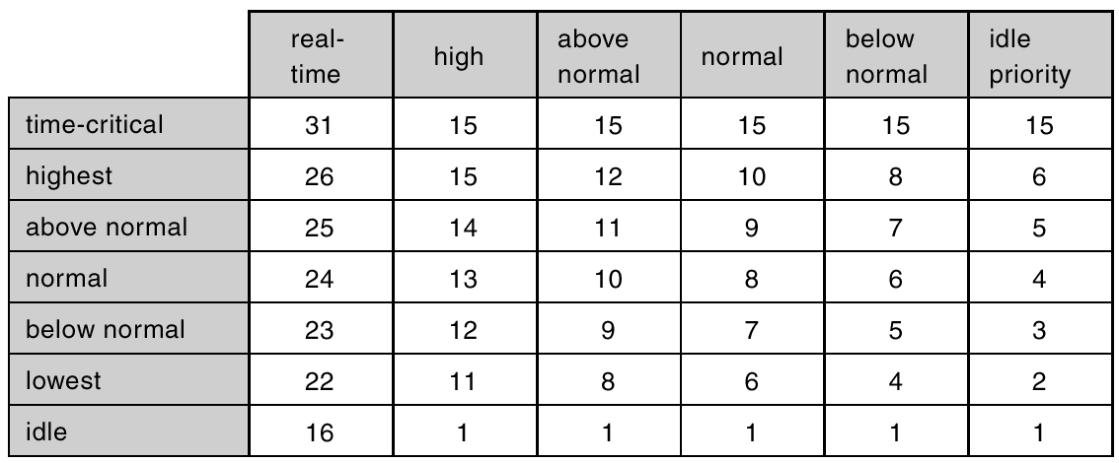
Process priorities example
Windows priorities:

Slide 18
Multi-processor scheduling
Different rules (or not) for identical processors
Use load balancing to distribute jobs, i.e. all processors have the same amount of information to process
Each processor uses scheduling by choosing processes from a common queue of ready-to-run processes (peer-to-peer machines) OR a master/slave model can be used

Slide 19
Process priorities
About creating, monitor and kill processes in Linux :
https://developer.ibm.com/tutorials/l-lpic1-103-5/
Process execution priorities in Linux:
https://developer.ibm.com/tutorials/l-lpic1-103-6/

Slide 20
CPU scheduling – more info
Wikipedia about CPU scheduling:
http://en.wikipedia.org/wiki/Scheduling_(computing)
Processes, Threads, Jobs, Quantum in Windows:
https://www.microsoftpressstore.com/articles/article.aspx?p=2233328&seqNum=7

